Slide 1
Test Automation Engineering Fundamentals: Java
Module 0: Setting up Envrionment

Slide 2
Activity
Install an IDE (IDEA)
Install the Java Development Kit
Create HelloWorld program and compile it using javac
Create and configure a project inside Idea importing the SEF work files
Compile and execute a simple Java application
Notes:
Key message:
As of this writing Java is now at version 6
The download is at http://java.sun.com
A copy of the installer should be with the SEF kit
Notes to Instructor: Please follow steps provided in slide# 9 through 21 to perform activity mentioned on the slide.

Slide 3
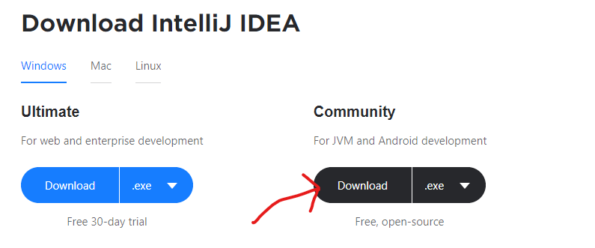
Go to IntelliJ download page → Press Download Community version as .exe file
Click - https://www.jetbrains.com/idea/download/#section=windows

Slide 4
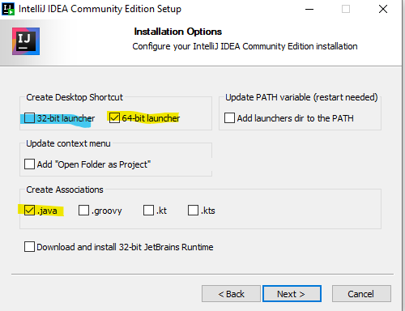
Open .exe file, click next, next, check like this and install

Slide 5
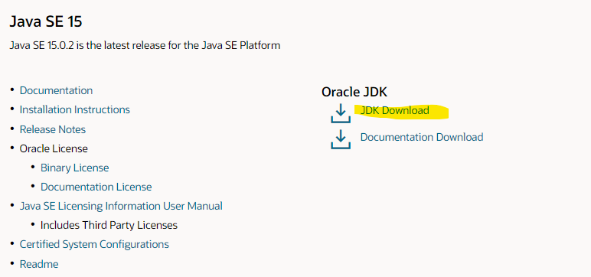
Install Java JDK latest latest version i.e. Java SE 15
Click - https://www.oracle.com/java/technologies/javase-downloads.html

Slide 6
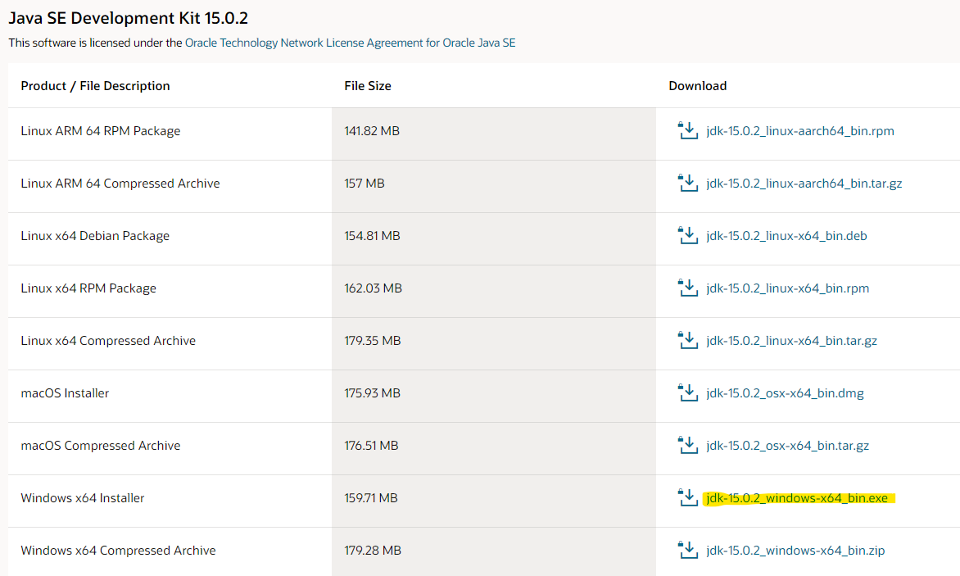
Choose the right installation

Slide 7
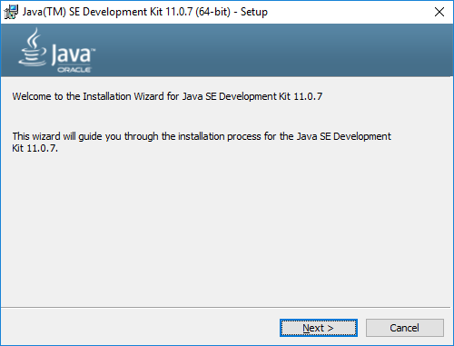
Open that, press next→next everywhere and install

Slide 8
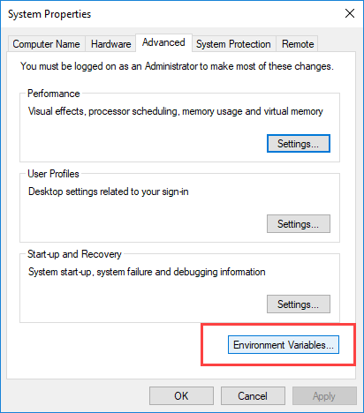
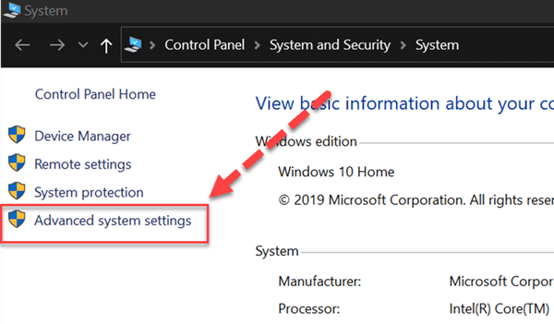
Set environment variables.
Go there:

Slide 9
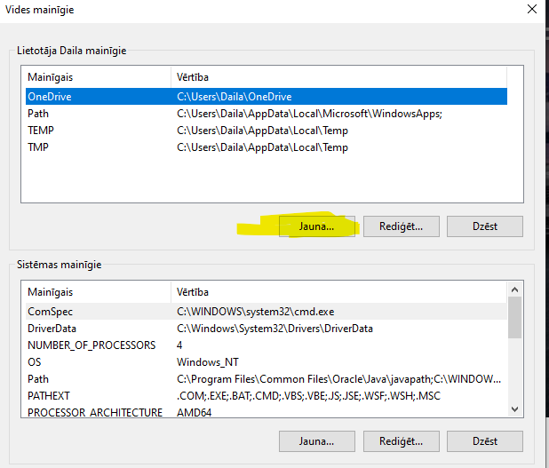

Slide 10
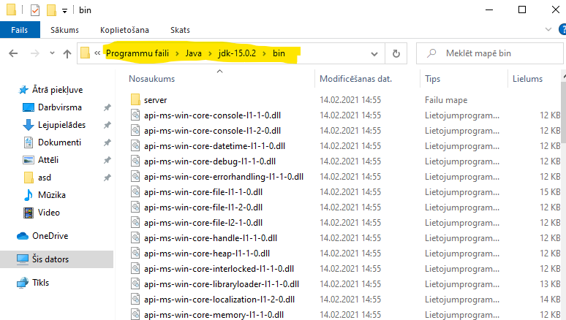
Find Java JDK installation bin folder and copy that path

Slide 11
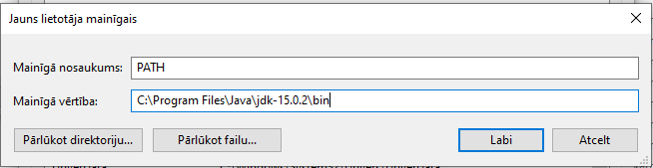
Create PATH variable like that:

Slide 12
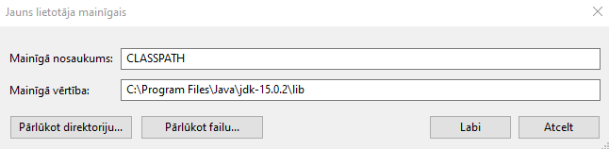
Create CLASSPATH variable like that as well, but with lib folder:

Slide 13
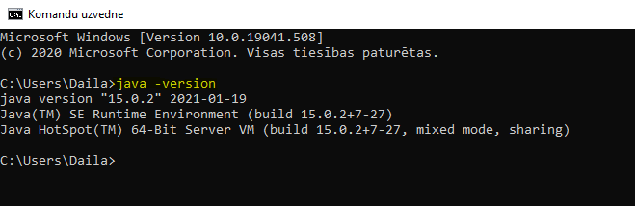
Go to Command Prompt → write «java –version»
If it shows yours just downloaded java version then you have successfully seted up Java path variables ☺

Slide 14
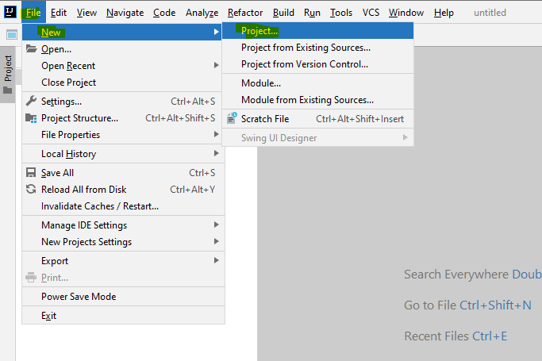
Open IntelliJ → Create new project and RUN IT
Like this:

Slide 15
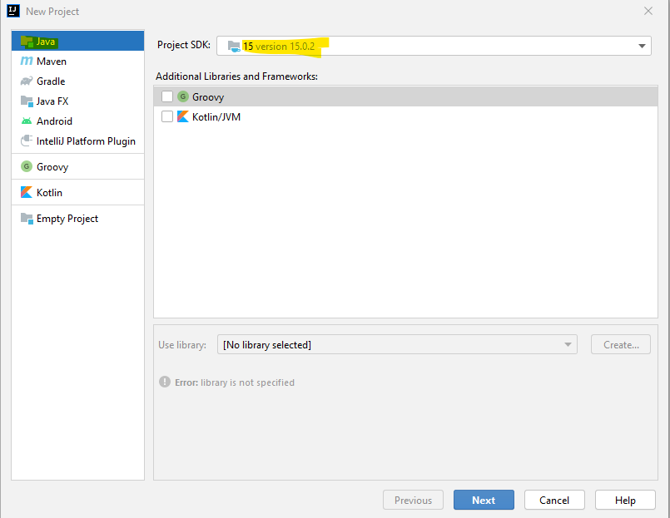

Slide 16
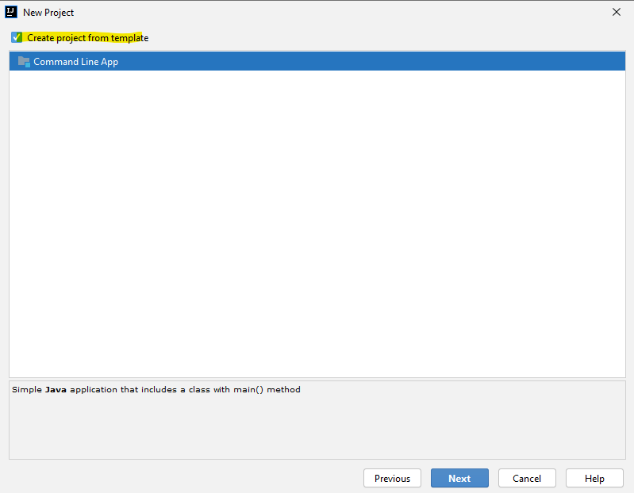

Slide 17
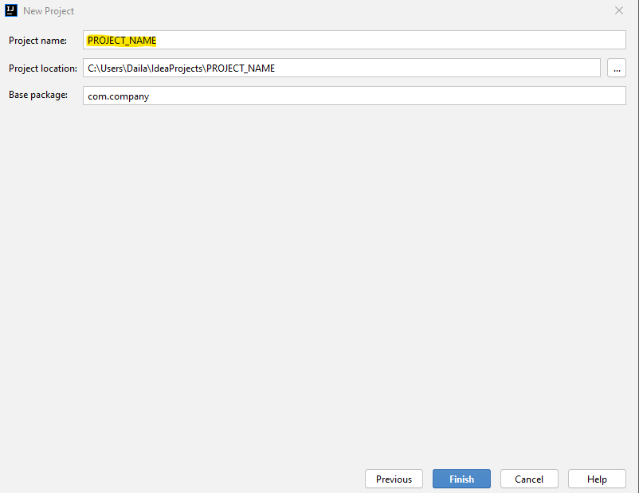

Slide 18
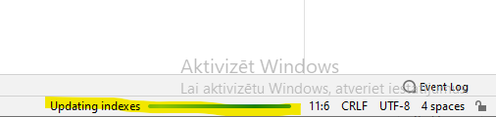
Wait little bit while it is configuring...

Slide 19
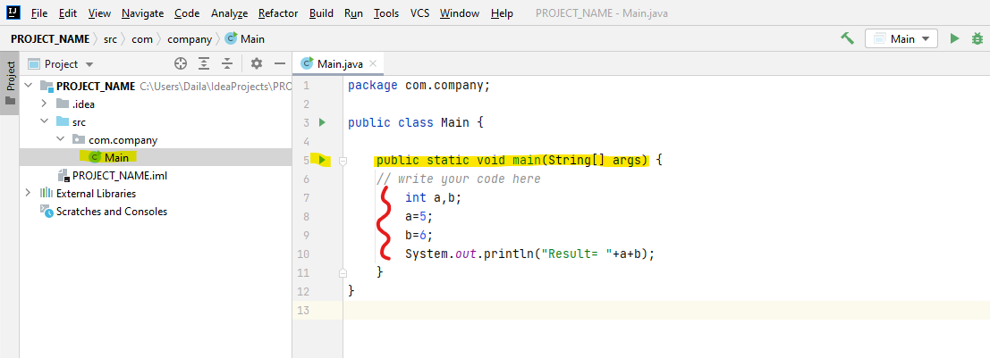
Write code like that and Press that green triangle(RUN from main).

Slide 20
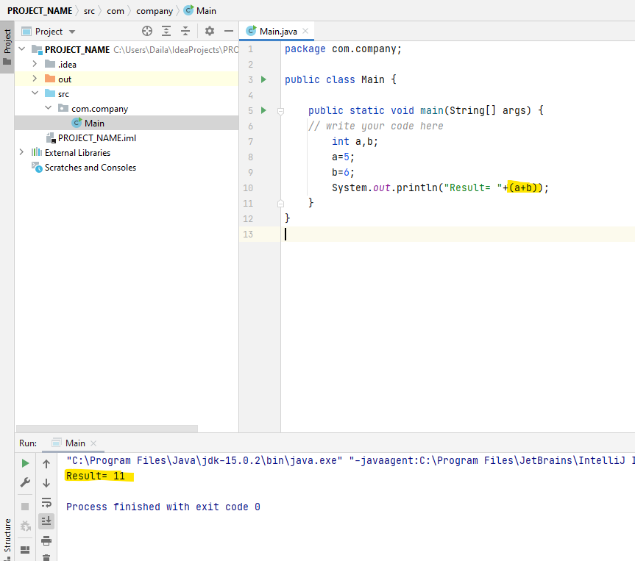

Slide 21
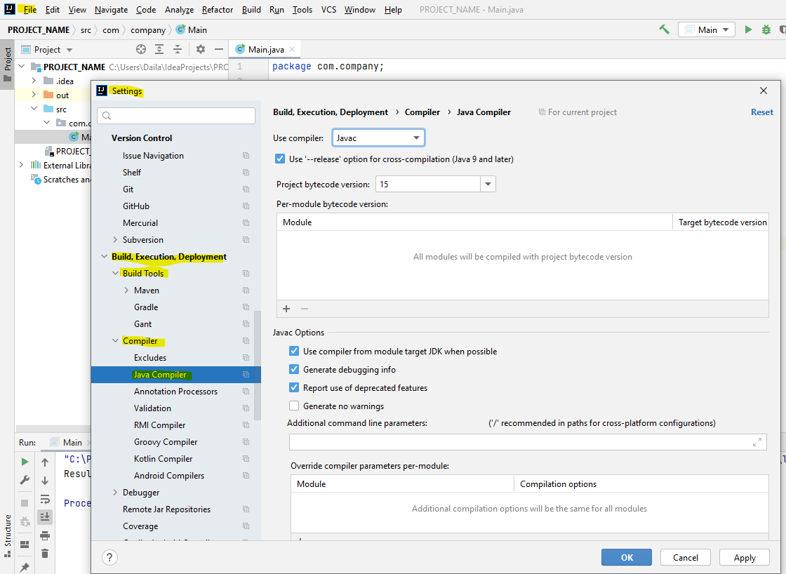
If getting any error → Check Java build tools and set settings correctly

Slide 22
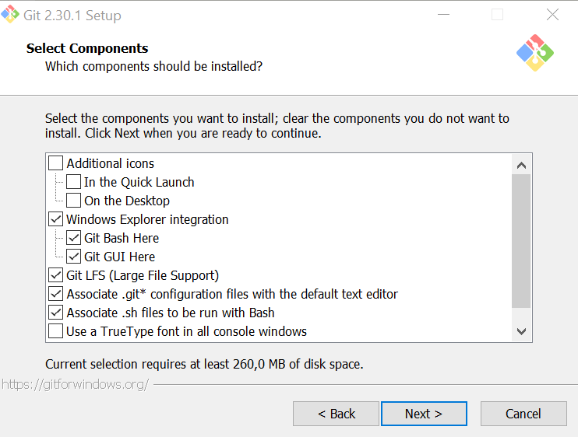
Now we need to create GitHub account and install GIT Bash.
Register here - https://github.com/
Install GIT Bash going here - https://git-scm.com/downloads
Click → Next, next everywhere and keep everything as default
Check like this and press... Next, next....

Slide 23
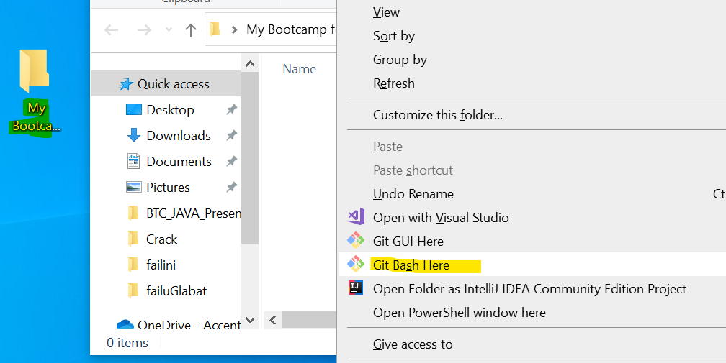
Create additional folder for your Java course and open Git BASH there. LIKE THIS:

Slide 24
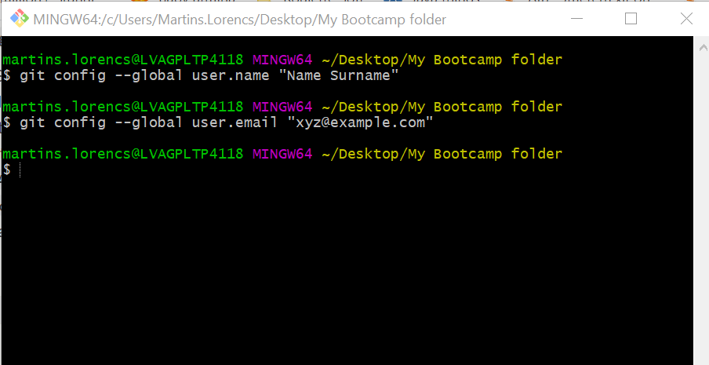
Set your username and email in GIT Bash like this:

Slide 25
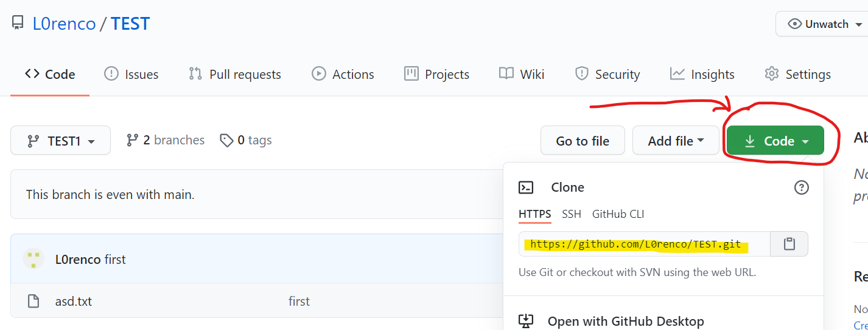
Now, go to Instructor given GitHub page and copy project’s HTTPS link

Slide 26
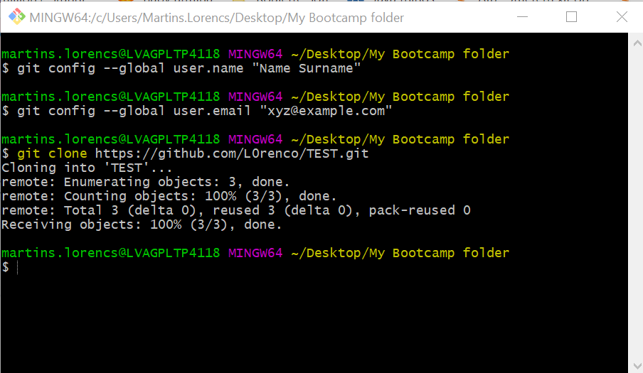
Go back to GIT Bash and paste link there with command – “git clone”, like THIS:
After cloning, you can close GIT Bash window

Slide 27
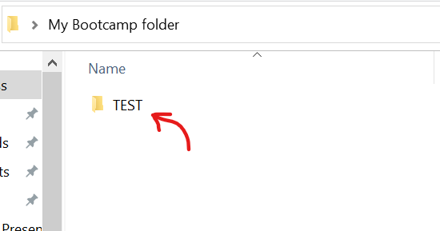
Git repository will be download IN your folder, so you have to go in that subfolder and there will be all files
Go THERE

Slide 28
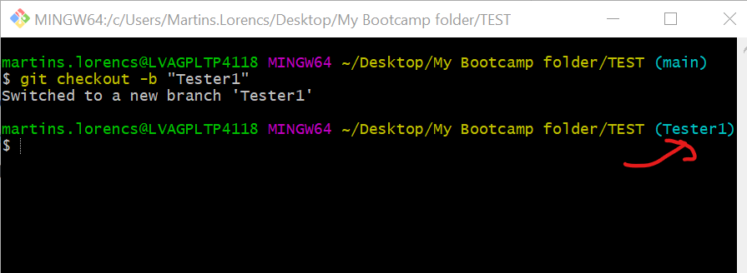
Open GIT Bash from there as previously…
Right click → GIT Bash here
Write “git checkout –b “Name_Surname”” to create your OWN branch – it is like YOUR working directory.
If successful, then you should be switched automatically to you branch… Like this(showed with arrow)

Slide 29
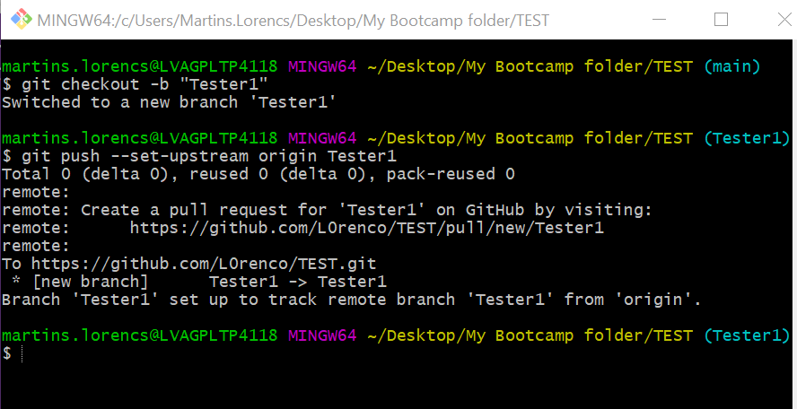
Then write command – “git push --set-upstream origin [branch_name]”.. To push the branch to GitHub. Like THIS:
//It can ask for you to log in from GitHub → So do it

Slide 30
Now you can start to complete TASKS and edit local files

Slide 31
After you have done your task and you are ready to push your code to GitHub use those commands:
“git pull” if you expect some changes from OTHERS in your branch, but in this case you can use command – “git fetch” to update YOUR branch from Instructor repository //This command is not mandatory, but it is like good practice to not make any conflicts. Remember this for your Group Project in week 4 ☺
“git status” to check what is changed. If you have added new files or changed them, then you can use command – “git add --all”
“git commit –m ‘’[comment]’’” to save local changes
“git push” to push changes to GitHub
Check example in next slide

Slide 32
